Slide 1
Version Control and Continuous Integration
Sven Erik Knop
@p4sven
Perforce Software
www.perforce.com
Aug 22, 2014
#jenkinsconf

Slide 2
Overview
Why version management for CI?
Why CI for version management?
The role of code review
How all this can be done in Perforce

Slide 3
Why version management for CI?
Foundation of Continuous Integration
Has all the data CI requires
Keeps the history and audit trail
Reproducible builds
Triggers the build

Slide 4




Just-in-time delivery

Slide 5
Triggering the build
Automatic
Committing into monitored code lines
Either through polling or externally (e.g. triggers)
User initiated
Code review
Pull requests

Slide 6
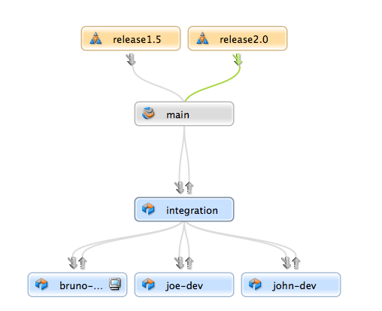
Why CI for Version Control?
It’s all about the mainline (master, trunk ...)

Slide 7
Mainline
The mainline model:
The source of all branches
The ultimate target of all changes
The mainline should be:
Always buildable
Always testable
Always deployable
Ideal: Always deliverable

Slide 8

Different Strategies to protect Mainline
Monitored integration streams
Pull requests
Pre-commit check
Initiate a review (ReviewBoard, Perforce Swarm)
Temporary server storage (Perforce shelves)
Or: break it and fix it quickly

Slide 9
The role of code review
Cost of bug fixing increases with the maturity of the product
Good code review can
Catch problems early to increase productivity and save money
Improve compliance with coding standards
Educate team members about the code

Slide 10

Improving your code review
Optimize reviewer’s productivity
Link code review and CI
Ensure changes build and pass their tests before they are being reviewed

Slide 11
How does this look like in Perforce?
What is Perforce?
Development Pipeline
Jenkins Integration

Slide 12

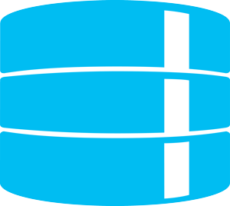




What is Perforce?
Massive Scalability
Distributed or centralized workflows
Collaboration
Multi-site Teams
Large Binaries
IP Security
Development
Headquarters
Manufacturing
Development

Slide 13









Perforce Powers Market Leaders
Games & Animation
Mobile ICs
Cloud/SaaS
Electronics
Finance
Enterprise
2,500 users
10,000,000 Perforce xact/day
Complete delivery pipeline
7,000+ releases/year
9,500 users
500+ terabytes
5,000+ users
coders & designers
13,000 → 20,000 users
11,000+ users
10+ sites
Everything!
11,000+ users
Notes:
We have 10000+ customers across the globe. This is a proven platform for delivering a diverse set of products.

Slide 14






Pipeline
Code review

Slide 15
Jenkins Plugin
Community
Old tech (P4 CLI)
Established
Base for other plugins (Job DSL)
Perforce
New tech (P4JAVA)
Enterprise-friendly (Credentials)
Review-friendly (shelving)
Knows Swarm

Slide 16
Demonstration

Slide 17
Summary
Version management needs CI
CI needs version management

Slide 18
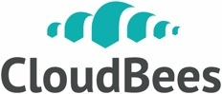






Thank You To Our Sponsors
Platinum
Gold
Silver

